Slide 1






PREDICTION OF MEDIAN ANNUAL SALARY OF DIFFERENT OCCUPATIONS
GROUP 1- ADTA 5340
AKSHITHA MULASTAM –11542615
VAMSHI KRISHNA VALLAM –11625644
SAHITHI GUDE – 11615109
HARSHITHA TELKALA – 11558364
RAVI CHANDRA CHOWDARY KAMEPALLI-11645414
JYOSTHANA EPANAGANDLA - 11489606
VAMSI ANDE – 11518655

Slide 2

AGENDA:
Introduction
Business Understanding
Data Understanding
EDA / Data Analysis
Data Preparation
Model Building/ Algorithms Used
Model Comparison and Predictions
Conclusion
References

Slide 3

INTRODUCTION
Use Case: Predicting Median Annual Salary of Different Occupations
Industry: IT
The main goal of this project is to forecast the median annual pay for various jobs based on a variety of characteristics including employment, occupational opportunities, typical entry-level education, work experience in a similar occupation, and typical on-the-job training. We have used Linear regression model and decision tree models to predict the target values.

Slide 4

BUSINESS UNDERSTANDING
Employers can track changes in employment levels for different occupations by using the employment in thousands supplied for 2021 and 2031. Additionally included are employment change and employment percent change from 2021 to 2031, which shed light on anticipated growth or decline in a variety of sectors.
The year 2021–2031 includes occupational openings, which are the number of new and replacement positions brought about by workers leaving the occupation. Businesses can use this information to plan ahead for recruiting needs and recruitment initiatives.
Finally, information on the expected cost of acquiring and keeping workers in various industries is supplied for each occupation, along with the median annual wage statistics for 2021.

Slide 5
Ethical Concerns of Data
Data are presented on the Bureau of Labor Statistics (BLS) Occupational Projections website from surveys, administrative records, and open data sources. To preserve people's privacy and avoid any harm or prejudice, it is crucial to make sure that the data acquired is anonymized and devoid of any personally identifiable information. To guarantee that the forecasts appropriately reflect the job landscape and do not sustain systemic prejudices, it is also crucial to address any potential biases in the data. Finally, in order to earn the public's trust, the BLS must be open and honest about the ways in which it gathers data, makes assumptions, and makes estimates.

Slide 6
DATA UNDERSTANDING
Data is gathered from the website: https://data.bls.gov/projections/occupationProj
Data includes various columns : Occupation Title, Occupation Code, Employment Change Percent 2021-2031,Median Annual Wage, Education code, Typical Entry Level Education etc..
Data has 832 rows and 14 columns.
Different statistical measures such as count, mean, standard deviation, minimum and maximum has been found.
Different python functions are used to find the missing values and outliers in the dataset.
Only the column Median Annual wage 2021 has missing values.

Slide 7
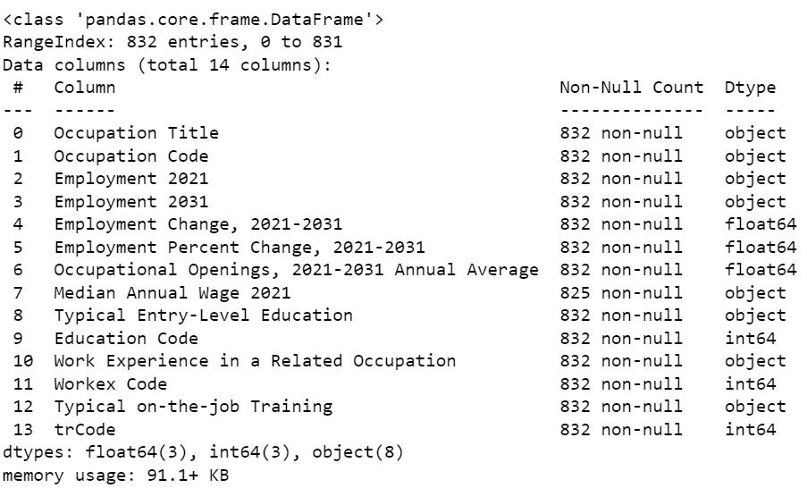
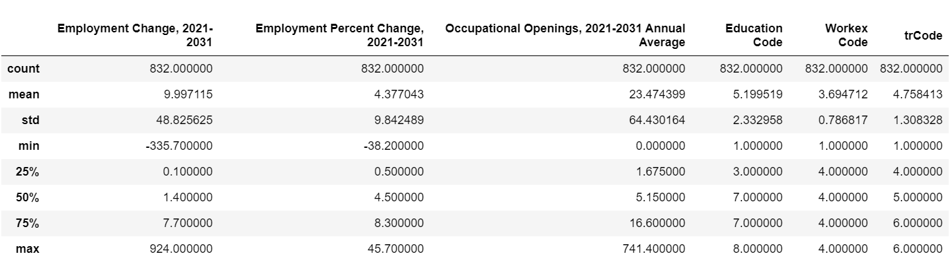
DATA UNDERSTANDING
Data Information
Summary Statistics

Slide 8
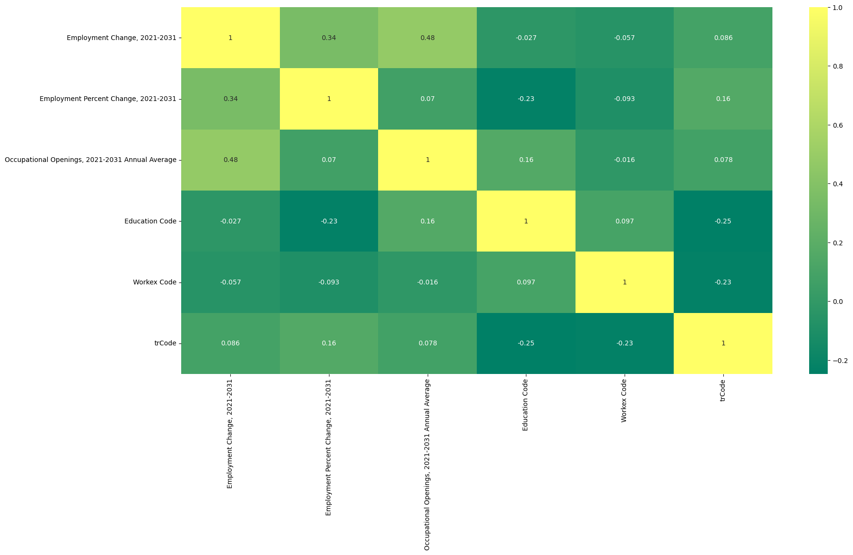
EDA/DATA ANALYSIS
Heatmap representing the correlation among various variables: Employment Change, 2021-2031 and Occupational Openings 2021-2031 Annual Average are showing 0.48(48%) of positive correlation.
All other variables are showing least positive/negative correlation.

Slide 9
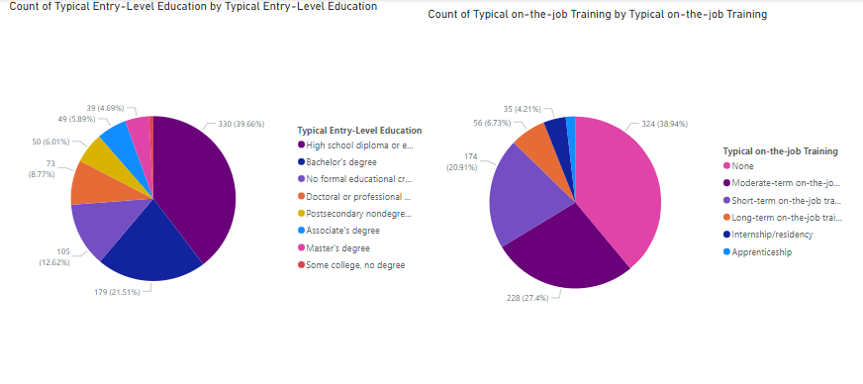
EDA/ DATA ANALYSIS
330 of the members having high school diploma as the Entry-Level Education, followed by 179 members have Bachelor’s Degree, followed by No formal Education, followed by Doctoral Degree.
324 of the members having None as the Typical-on-job training, followed by 228 have undergone Moderate-Term-on-the –job training(27.4%), followed by short-term-on-the-job training( 20.9%).

Slide 10
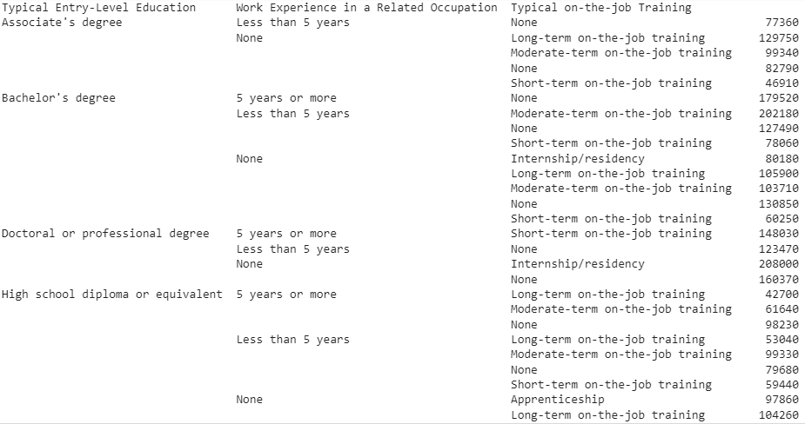
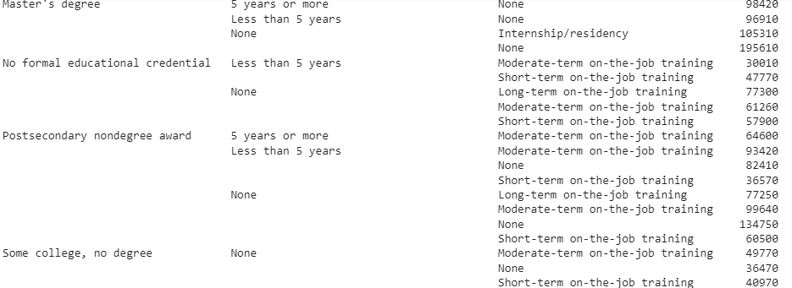
EDA/Data Analysis
Pivot Table showing multi-variate analysis of Typical Entry-Level Education, Work Experience in a Related Occupation, Typical on-the-job Training and Median Annual Wage.
From the table it is clear that, Maximum of Median Annual salary($208000) is high for people having Doctoral Degree+ <5 years of work experience + Internship on-the-job Training
followed by people having Bachelors Degree + <5 years of work experience+ Moderate-Term-on-the-job-training nearly ($202180)
followed by people having Master’s Degree + None(Experience)+None(on-the-job training) having ($195610)

Slide 11
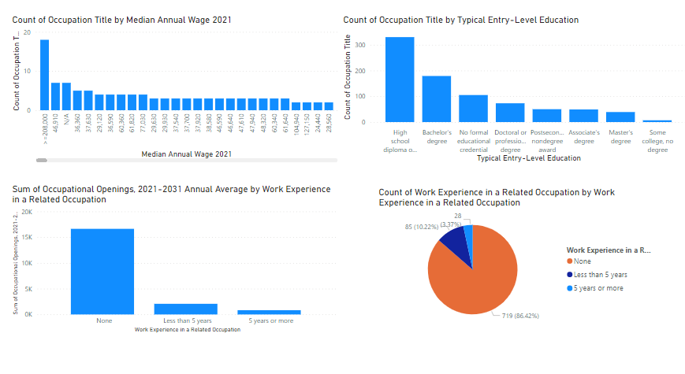
EDA /Data Analysis
The following analysis is done using PowerBI tool.
Majority of the Occupations around 18 having Median Annual wage 2021 is >=208000, only 2 occupations having annual wage 127150 and most of the occupations have Annual wage in between 35000-60000
Highest count of work experience in related field(719) is None, followed by Less than 5 years (85) and >=5 years count is 28.
Sum of occupational openings for None is 16,632 followed by <5 years of work experience is 2,068 and >5 years or more of work experience is 829.

Slide 12
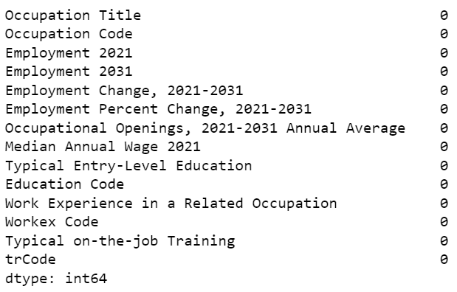

DATA PREPARATION
Data preparation entails cleaning and pre-processing data before it can be analyzed. This involves deleting duplicate or irrelevant data, dealing with missing information, converting data to an appropriate format, and maintaining data consistency. Outliers and anomalies in the data should also be searched for as they may alter the results. For precise and dependable findings, proper data preparation is required.
Handling Missing values

Slide 13
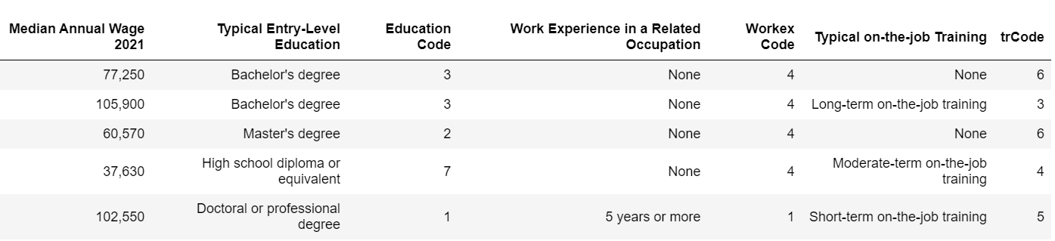
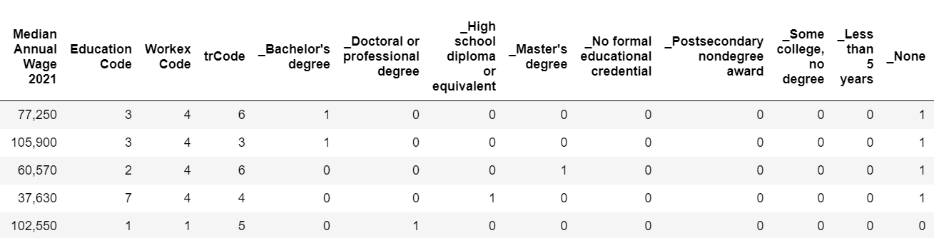
ii) Choosing the important variables for modeling.
Converting the categorical variables into dummies

Slide 14
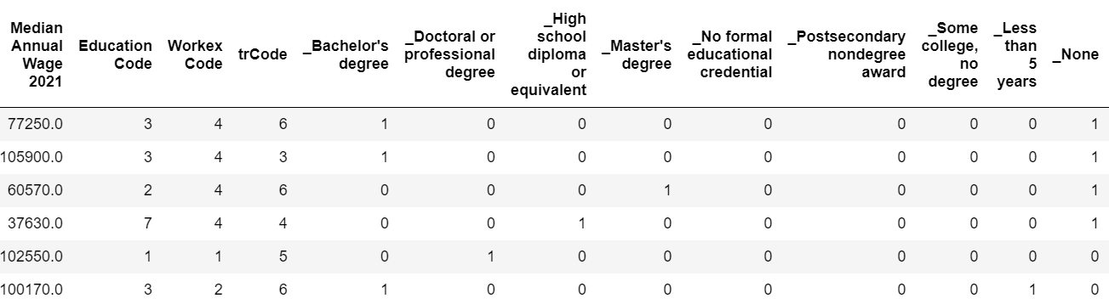
iv) Remove the special symbols from the data.

Slide 15
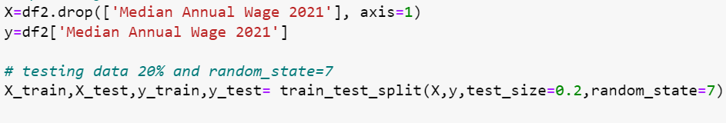
v) Splitting the data into training and testing. We have used 80% of the data for training and 20% for testing.

Slide 16

DATA MODELING
Data modeling entails creating a predictive model based on data. Other models, including linear regression, decision trees, and neural networks, can be utilized. The model chosen will be determined by the nature of the data and the research topic being addressed. To guarantee that the model is accurate and dependable, it should be tested using metrics such as mean squared error, R-squared, or correctness.
In this project, we have used 2 models, which are,
1. Linear Regression model
2. Decision Tree model

Slide 17
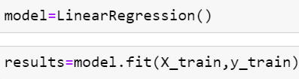
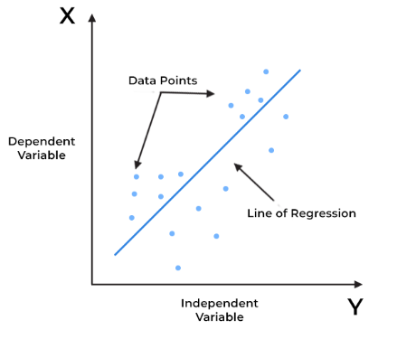
1. Linear Regression
It is used to predict the value of one variable based on other variables.

Slide 18
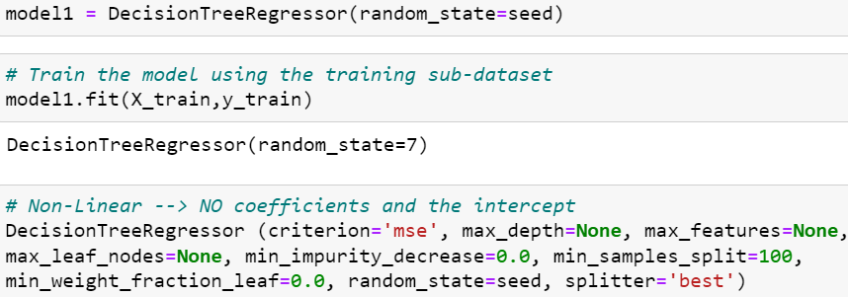
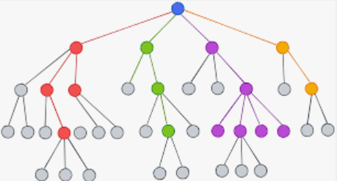
2. Decision Trees
Decision Trees create a model that helps in predicting the value of simple decision rules that are inferred from the data features.

Slide 19
MODEL COMPARISON AND PREDICTIONS
Linear Regression
R-Squared= 0.705
Decision Trees
R-Squared= 0.792
We are predicting the median annual wage with Education code=7, Workex Code= 4, TrCode= 4, High School diploma or Equivalent education, No work experience, and moderate on-the-job training.
The median annual wage for the same variables is $37360.
Linear Regression
$45302.6210
Decision Trees
$44860.31496

Slide 20

CONCLUSION
The model's efficiency in forecasting the median annual pay for various occupations is evaluated. This can be accomplished by calculating the error between expected and actual income. The model should be refined based on the evaluation findings to improve accuracy and reliability. The evaluation findings should be disseminated to stakeholders to inform decision-making.
In this project, we have evaluated the performance of the decision tree model on the test data set using the R-squared metric, evaluated the model using k-fold cross-validation, and evaluated target values for both models.

Slide 21
REFERENCES
Das, S., Barik, R., & Mukherjee, A. (2020, February 04). Salary Prediction Using Regression Techniques. Papers.ssrn.com. https://papers.ssrn.com/sol3/papers.cfm?abstract_id=3526707
‌Employment Projections. (2018). Bls.gov. https://data.bls.gov/projections/occupationProj
Tee, Zhen & Raheem, Mafas. (2022). Salary Prediction in Data Science Field Using Specialized Skills and Job Benefits -A Literature Review. 70-74.

Slide 22
ANY QUERIES?
THANK YOU

Slide 23
TEAM CONTRIBUTION
AKSHITHA MULASTAM: Dataset search, Exploratory Data Analysis, PPT
VAMSHI KRISHNA VALLAM: Problem Statement, Algorithm Selection and Data Modeling
SAHITHI GUDE: Data Preparation and Project Report
HARSHITHA TELKALA: Project Report and Model Evaluation
RAVI CHANDRA CHOWDARY KAMEPALLI: Data Preparation and PPT
JYOSTHANA EPANAGANDLA: Coding, Pseudocodes, Comments, and Workflow
VAMSI ANDE: PPT , Business Understanding, Meeting Notes

